Slide 1
IMDB Movies SQL Analysis Project
Presented by Manndeep Patel and Satyam Sharma
Project Team ID: PTID-CDA-JAN-26-1165
Project ID: PRSQL-01
Intro

Slide 2
Task Questions Covered (Checklist)
Covered in the slides:
Get all the data about movies.
Get all the data about directors.
Checked how many movies are present in IMDB.
Count total movies.
Find directors starting with ‘S’.
Find specific directors (James Cameron, Luc Besson, John Woo).
Count female directors.
10th female director (ORDER BY + OFFSET).
Top 3 popular movies.
Top 3 bankable movies.
Highest-rated movie since Jan 1, 2000.
JOIN query (movies directed by Brenda Chapman).
JOIN query (movies by director).
Most Bankable Director.
checklist

Slide 3
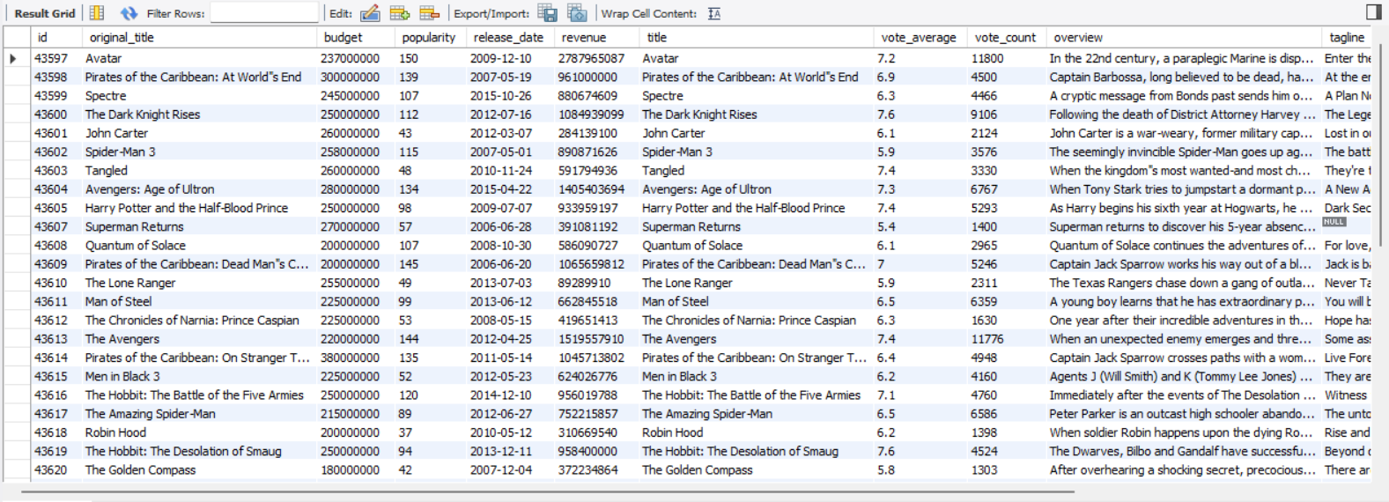
Task – 1: Get all the data from movies table
SQL Query:
select *
from movies;
Insights: Display complete information about the movies data set table.
Task -1

Slide 4
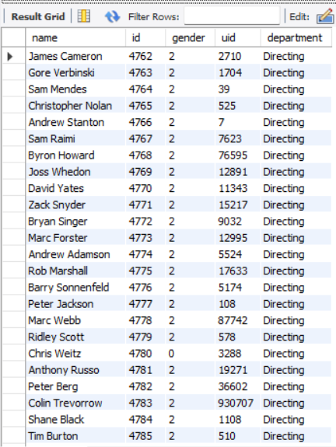
Task – 2: Get all the data from Directors Table
SQL Query:
select *
from directors;
Insights: Display all information about the directors data set table.
Task -2

Slide 5
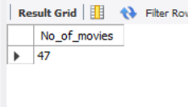


Task – 3: Total Movies Present in IMDB
SQL Query:
Insights: Counts total number of movies in the data set from movies data set.
select count(original_title)as No_of_movies
from movies;
Task -3

Slide 6
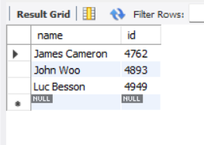
Task – 4: Find Directors: James Cameron, Luc Besson, John Woo
SQL Query:
Insights: Display of 3 directors names are James Cameron, Luc Besson, John woo from directors data set.
select name, id
from directors
where name in ("James Cameron", "Luc Besson", "John Woo");
Task -4

Slide 7
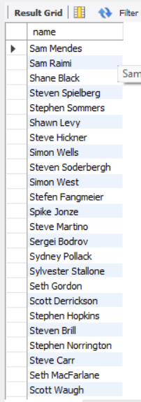
Task – 5: Find Directors name starting with “S”
SQL Query:
Insights: The Data of the directors whose name starting with “S” from directors data set.
select name
from directors
where name Like
"S%";
Task -5

Slide 8

Task – 6: Count female Directors
SQL Query:
select gender, count(gender)as female_directors
from directors
where gender="1";
Insights: Count of only Female directors from directors data set.
Task -6

Slide 9

Task – 7: Find Name of 10th first women director
SQL Query:
select gender , name
as female_directors
from directors
Where gender=‘1’
order by
name
Limit 1 offset 9;
Insights: The Data showing the 10th first female director after sorting and ordering the data from directors data set.
Task -7

Slide 10
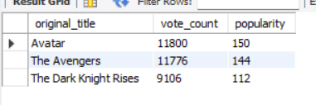
Task – 8: Three Most Popular Movies
SQL Query:
select original_title, vote_count, popularity from movies
order by vote_count DESC, popularity DESC limit 3;
Insights: Display of the most popular movies according to popularity and vote count from movies data set.
Task -8

Slide 11
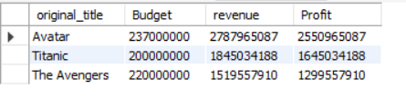
Task – 9: 3 Most Bankable Movies
SQL Query:
select original_title,Budget,
revenue,Revenue-Budget as Profit
from movies
order by revenue DESC
limit 3;
Insights: Display of most earned revenue means bankable in terms of movie industry with profit showing after deducting budget from revenue from movies data set.
Task -9

Slide 12

Task – 10: Most Awarded Average Vote since January 1st 2000
SQL Query:
select original_title, vote_average
from movies
where release_date >='2000-01-01’
order by vote_average DESC
limit 1;
Insights: Display of most awarded average vote since January 1st 2000 from movies data set.
Task -10

Slide 13
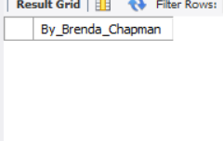
Task – 11: Movies Directed by Brenda Chapman
SQL Query:
Note: The Query hasn’t returned any query because the movie table has no data regarding the Brenda Chapman movies.
select distinct m.original_title as By_Brenda_Chapman
from movies m join directors d on m.director_id=d.id
where d.name = "Brenda Chapman";
Insights: Join query performed to get the movies directed by the Brenda Chapman
Task -11

Slide 14
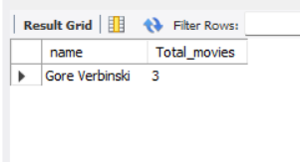
Task – 12: Director Made the most Movies
SQL Query:
SELECT d.name, COUNT(*) AS Total_movies
FROM directors d
JOIN movies m ON d.id = m.director_id
GROUP BY d.name
ORDER BY Total_movies DESC
LIMIT 1;
Insights: Join query performed to derive the data of which director made the most movies.
Task -12

Slide 15
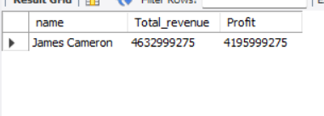
Task – 13: Most Bankable Director
SQL Query:
select d.name, sum(m.revenue) as Total_revenue, sum(Revenue-Budget) as Profit
from directors d
join movies m on d.id = m.director_id
group by d.name
order by Total_revenue DESC
limit 1;
Insights: Join query performed to derive the data of which director is most bankable.
Task -13

Slide 16
Thank You

